Slide 1


Root-x Secure Safeguarding the Digital Landscape
PRESENTED BY:
A. F. M. RAFIUL HASSAN
Course: Engineering Ethics
SL: 23
ID: 22-47048-1
Instructor: Dr. Shuvra Mondal

Slide 2


Root-x Secure
Safeguarding The Digital Landscape
Root-x Secure is a international company provides comprehensive solutions to proactively protect your business and organizations from evolving threats.

Slide 3

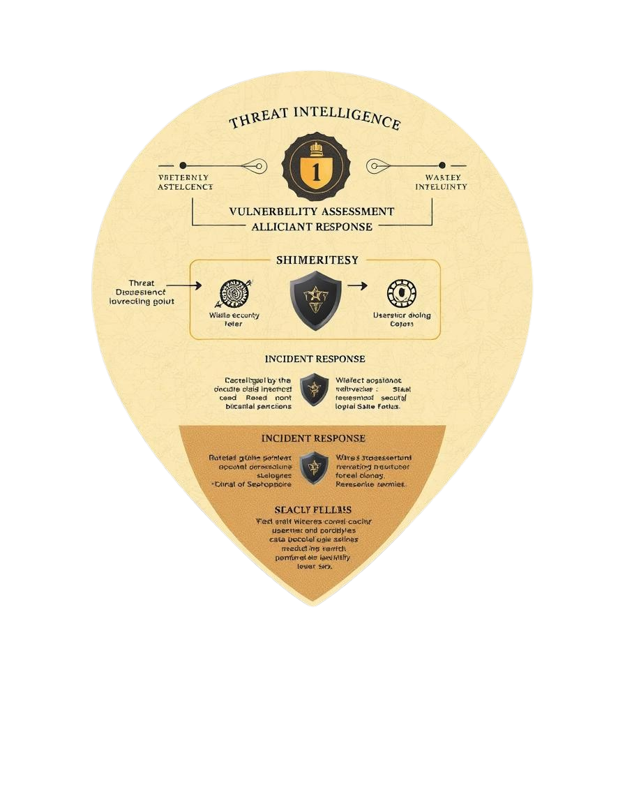
01
Threat Intelligence
02
Vulnerability Assessment
03
Incident Response
Mitigating Cyber Attacks

Slide 4

Our Approach
Encryption
We use advanced encryption techniques to safeguard sensitive data, ensuring its confidentiality and integrity.
Monitoring
Our 24/7 monitoring systems actively detect and respond to suspicious activity, providing real-time protection against threats.

Slide 5





Organizational Hierarchy
1
CEO
2
CTO (Chief Technology Officer)
3
CISO (Chief Information Security Officer)
4
Head of Cybersecurity Operations
5
Cyber Analysts and Incident Response Team

Slide 6



Code of Ethics & Conduct
INTEGRITY
CONFIDENTIALITY
TRANSPARENCY
Upholding the highest ethical standards in all our interactions.
Client data and information are treated with the utmost confidentiality.
Open communication and transparent practices build trust with our clients.

Slide 7
Ethical Guidelines
01
02
03
Data Privacy
Responsible Disclosure
Security Awareness
We prioritize public interest and data privacy and comply with relevant regulations.
We encourage responsible disclosure of vulnerabilities.
We promote security awareness among our clients and employees.

Slide 8
Conclusion
Root-x Secure is committed to safeguarding the digital landscape through ethical practices, robust security measures, and a proactive approach to threat mitigation. We prioritize data privacy, responsible disclosure, and security awareness to build trust and ensure a secure digital future for our clients.

Slide 9
References
IEEE Code of Ethics
https://www.ieee.org/content/dam/ieee-org/ieee/web/org/about/corporate/ieee-code-of-ethics.pdf
Intel Code of Conduct
https://www.intel.com/content/dam/www/central-libraries/us/en/documents/code-of-conduct-english.pdf

Slide 10
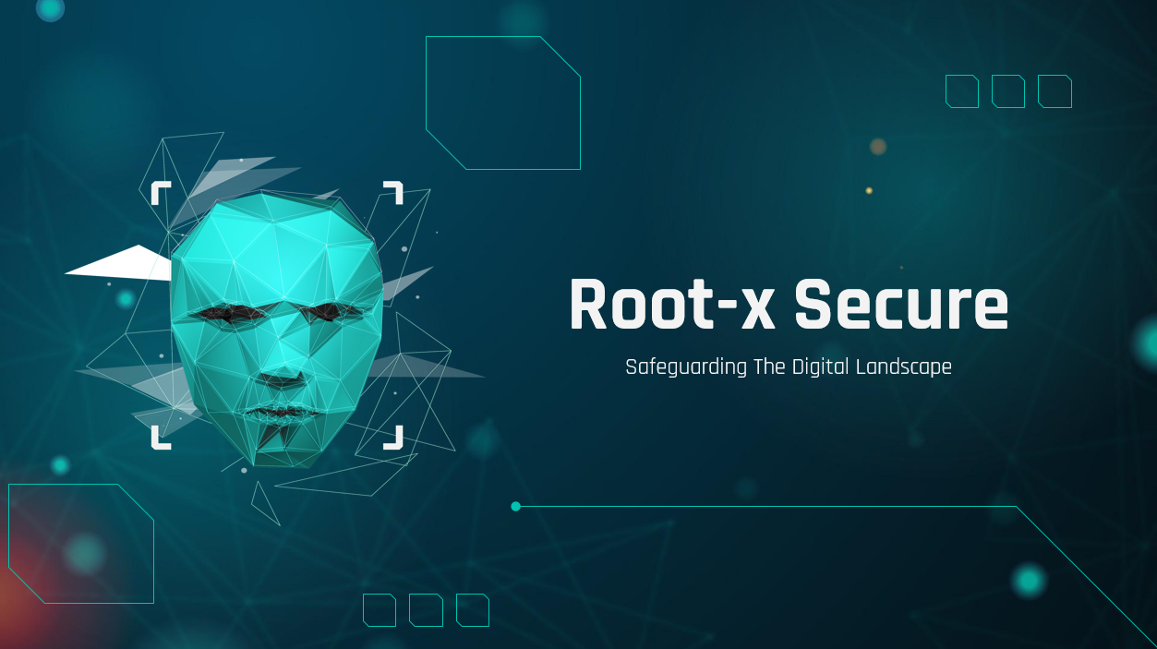
Thank You!

